Slide 1
Refreshed Medica Broker Portal

Slide 2
Agenda
Portal refresh background
New portal preview
Re-registration process
Multi-factor authentication
New admin view
Next steps
Questions?

Slide 3
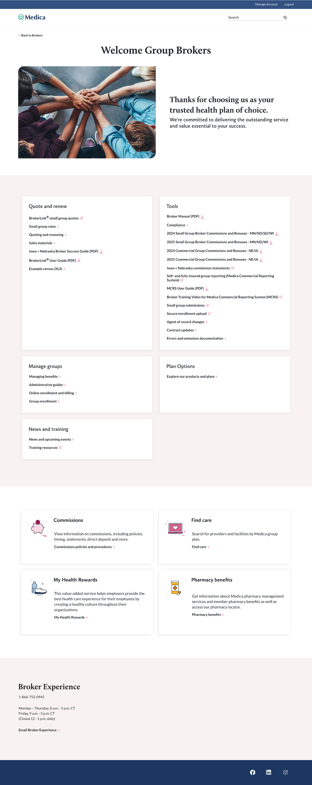
What problem are we solving?
We’ve heard from our broker partners that the current portal experience can be challenging to navigate.
Finding the right tools and resources quickly isn’t always easy.
Separate login screens existed for each line of business.
Login technology needed to be upgraded.

Slide 4

What is the goal of the refreshed portal?
The goal is to deliver a seamless and intuitive broker experience by enhancing navigation, streamlining workflows, and elevating overall usability across our digital platforms.
The project also upgrades the login technology and enhances security.

Slide 5
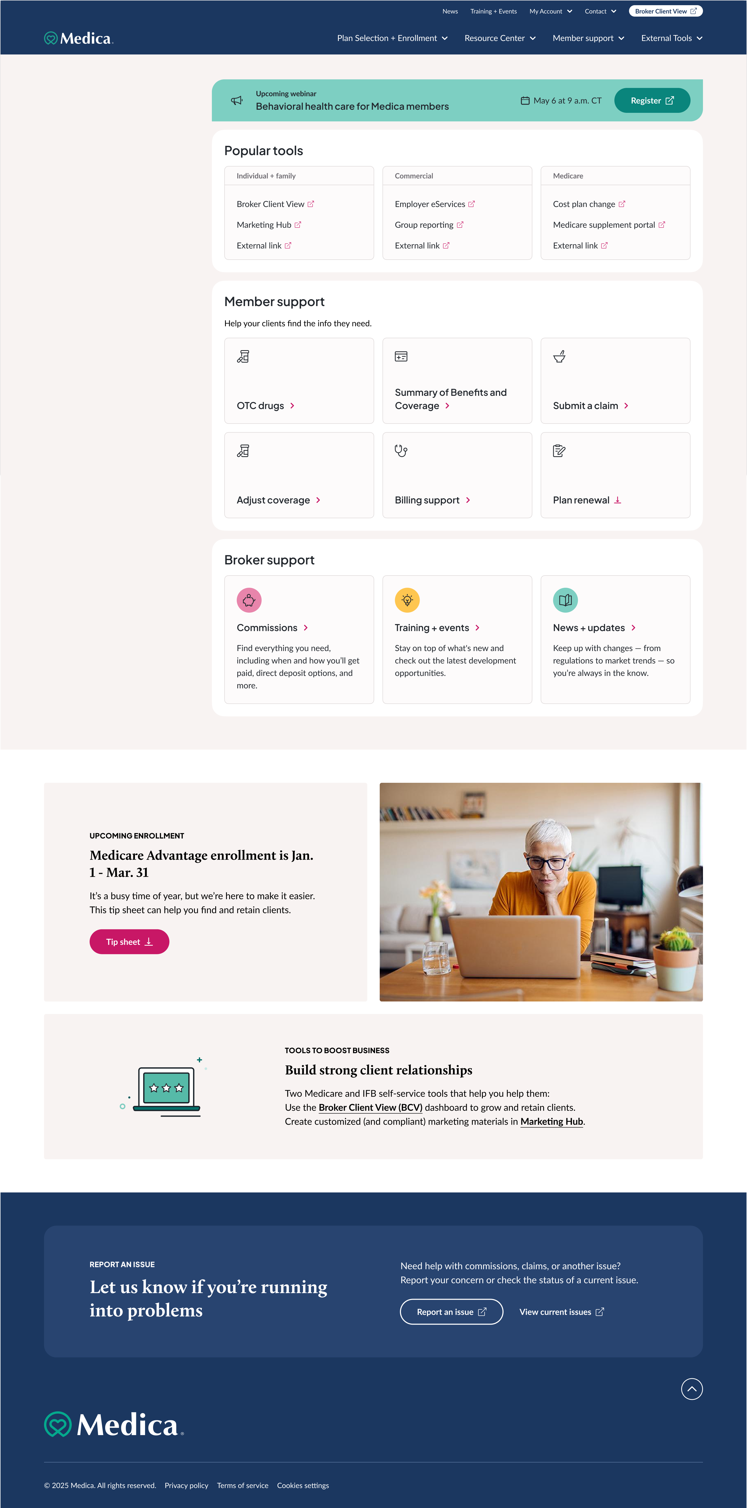
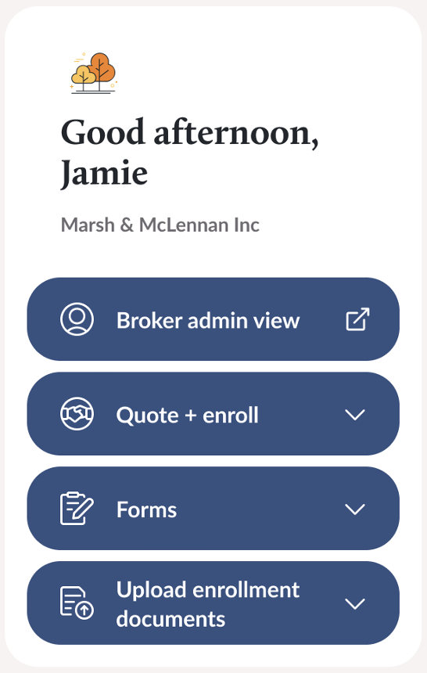
Refreshed design
Design updates include:
One portal experience for all lines of business
Flexible layout with content hierarchy
Fully optimized responsive design
Site navigation to improve wayfinding

Slide 6



Key experience updates
In addition to the updated design and user experience, other key updates include:
ALL brokers will need to re-register for portal access starting March 6
Multi-factor authentication is now required
A broker admin view has been added for support roles

Slide 7
Broker Portal Re-Registration

Slide 8
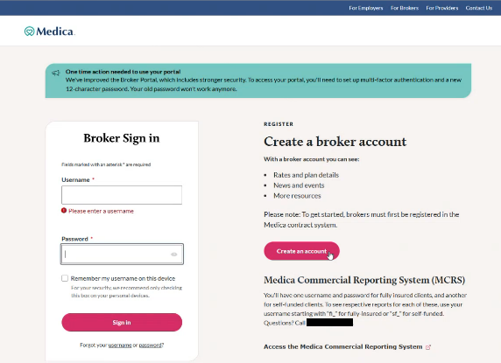
Broker Portal Re-Registration
All registered brokers will need to re-register for portal access

Slide 9
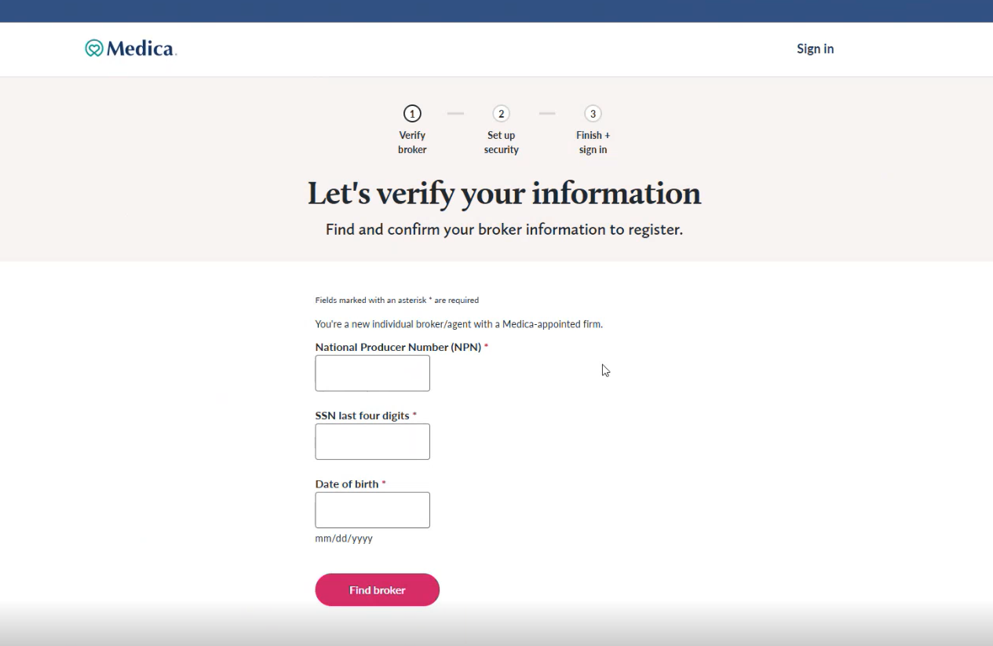

Slide 10
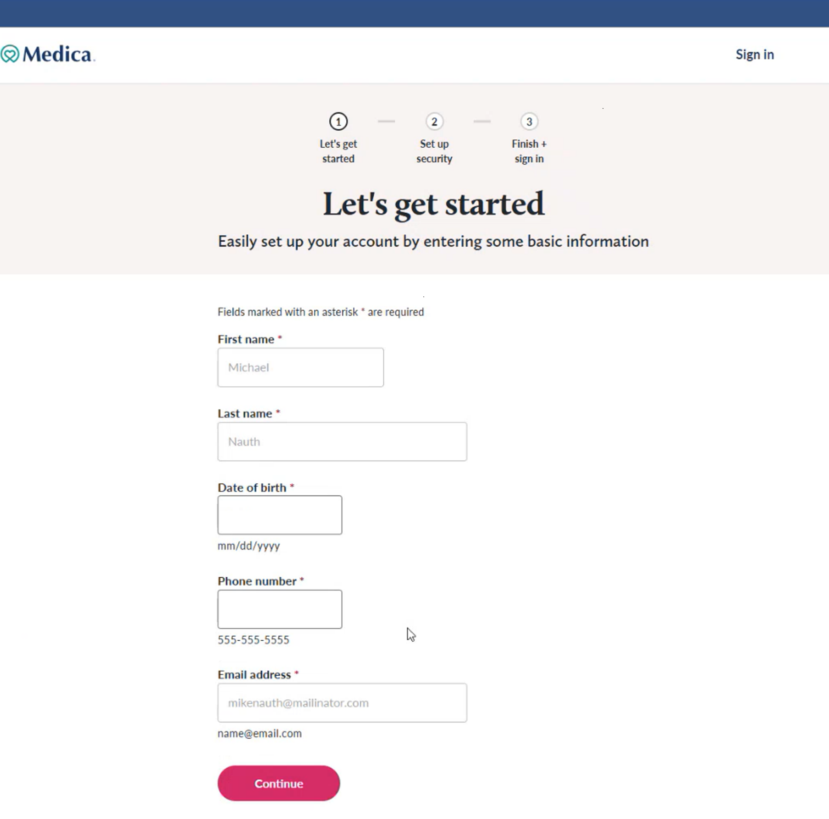

Slide 11
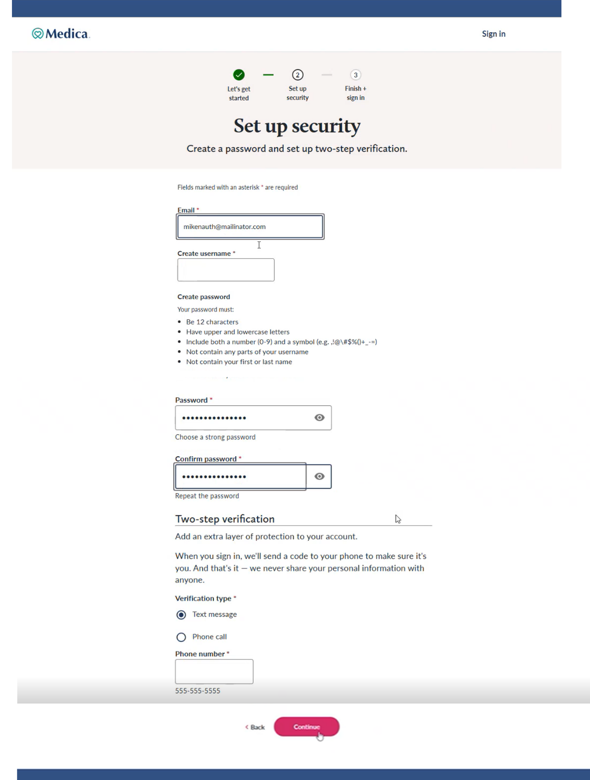
Must be a cell phone number (not a landline)

Slide 12
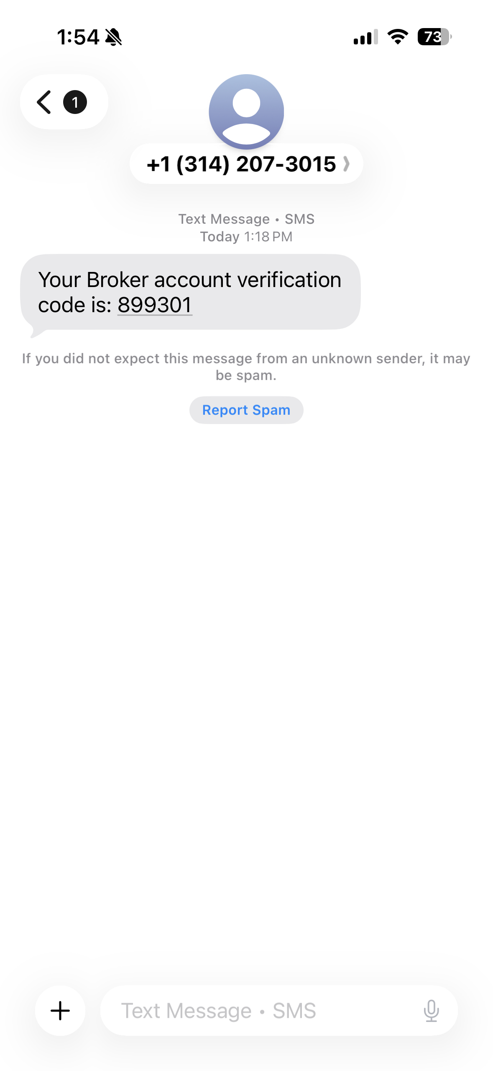
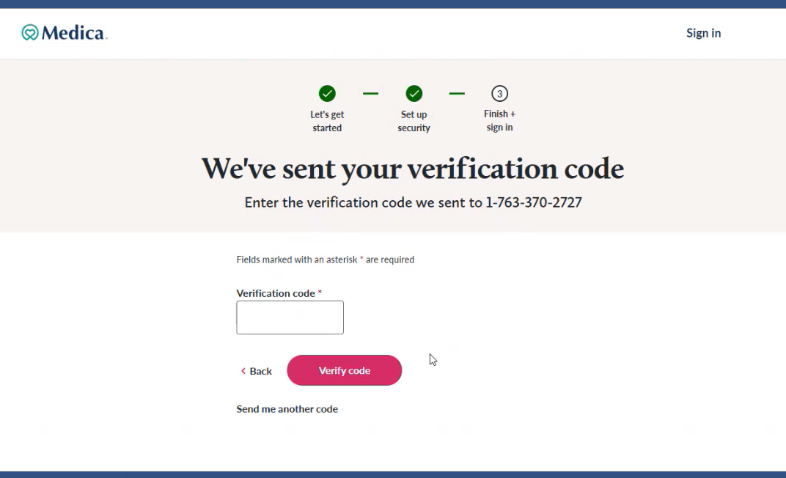
Broker Portal Re-Registration

Slide 13
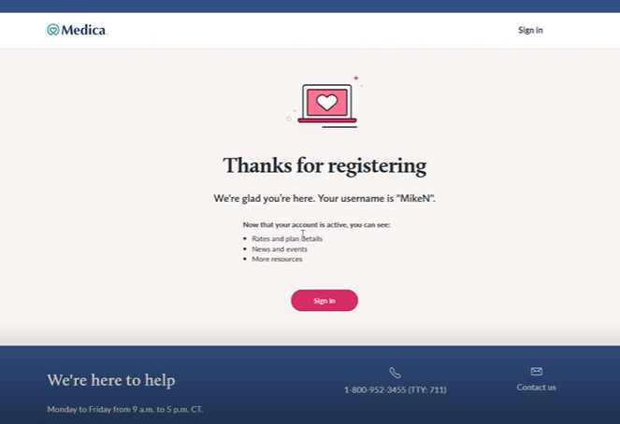
Broker Portal Re-Registration

Slide 14
Multi-Factor Authentication

Slide 15
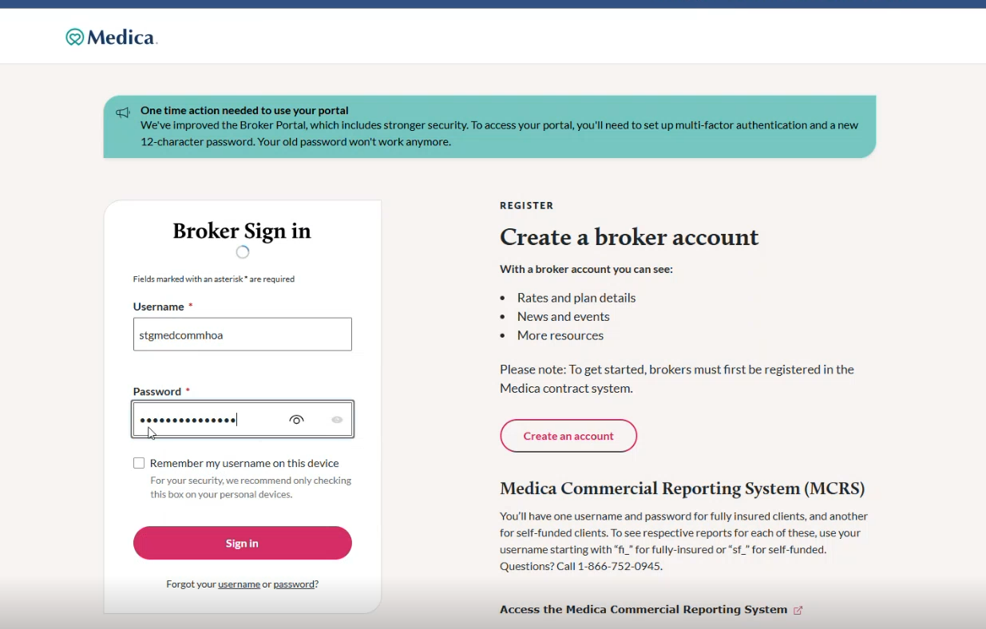
Multi-Factor Authentication (MFA)
MFA is being added to enhance portal security

Slide 16
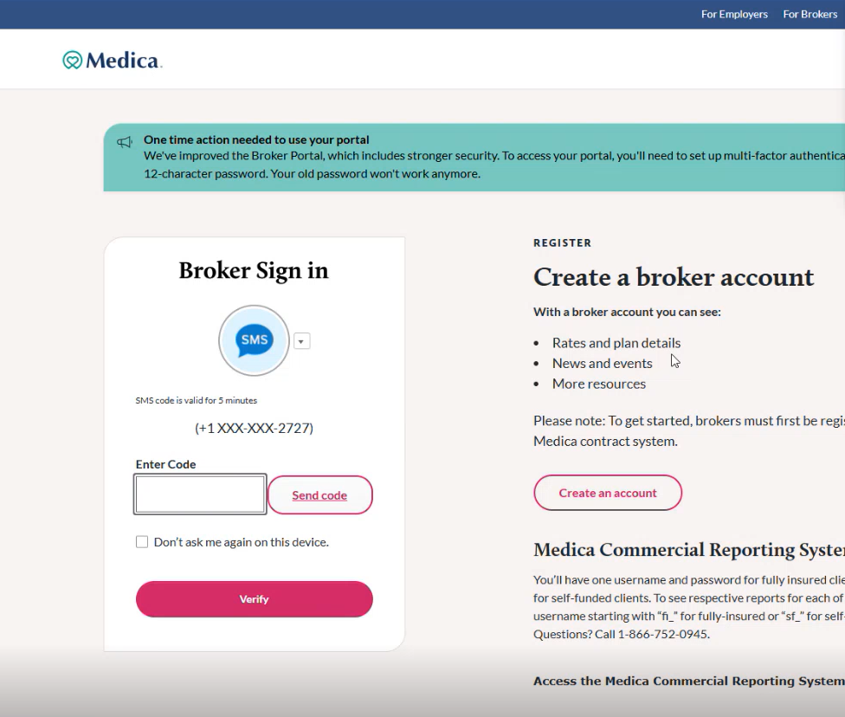

Slide 17
New Admin View

Slide 18
New Admin View
Admins now have their own Broker Portal login
To get started, an agent invites an admin to register
An admin receives a link to register for portal access
Agents can designate which admin(s) can act on their behalf

Slide 19
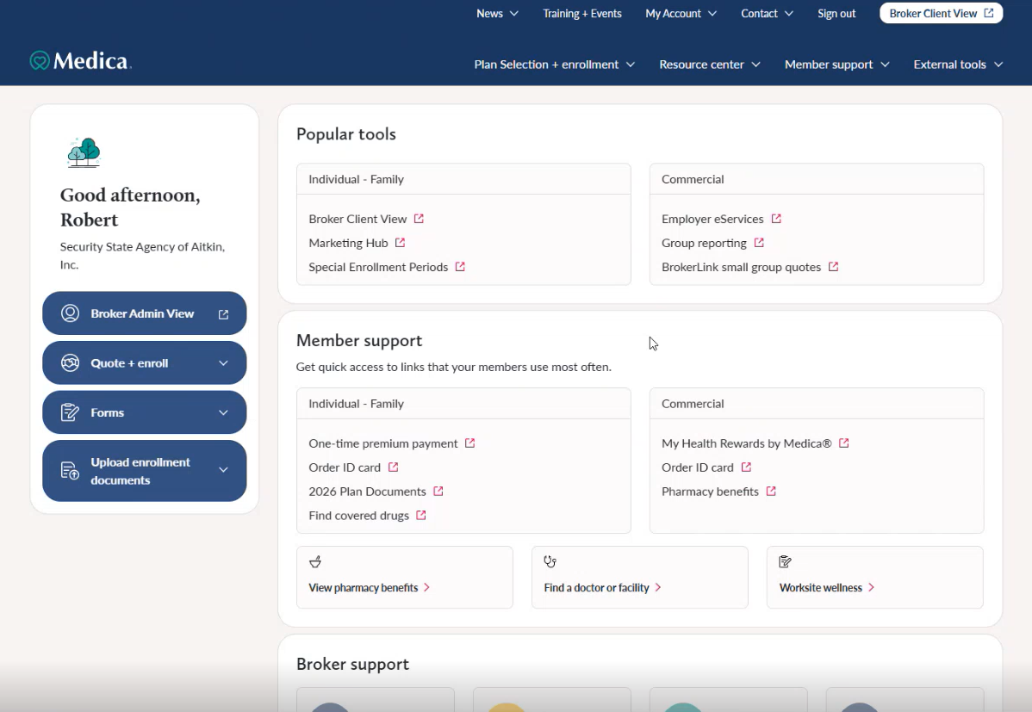
Agent View
To get started, an agent clicks on the Broker Admin View button

Slide 20
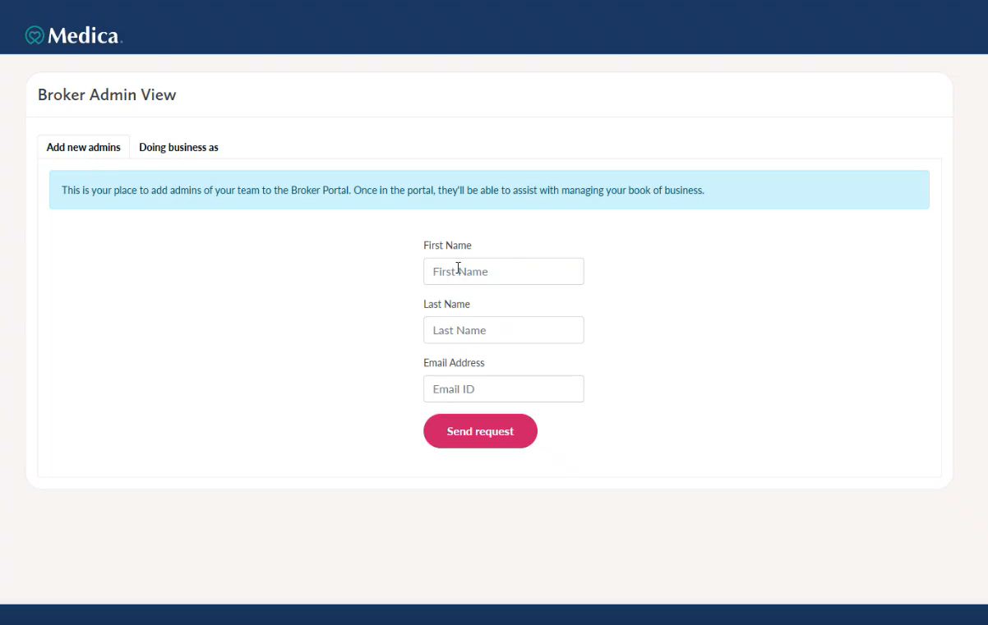
Agent View
Next, they add their admin’s info and send request

Slide 21
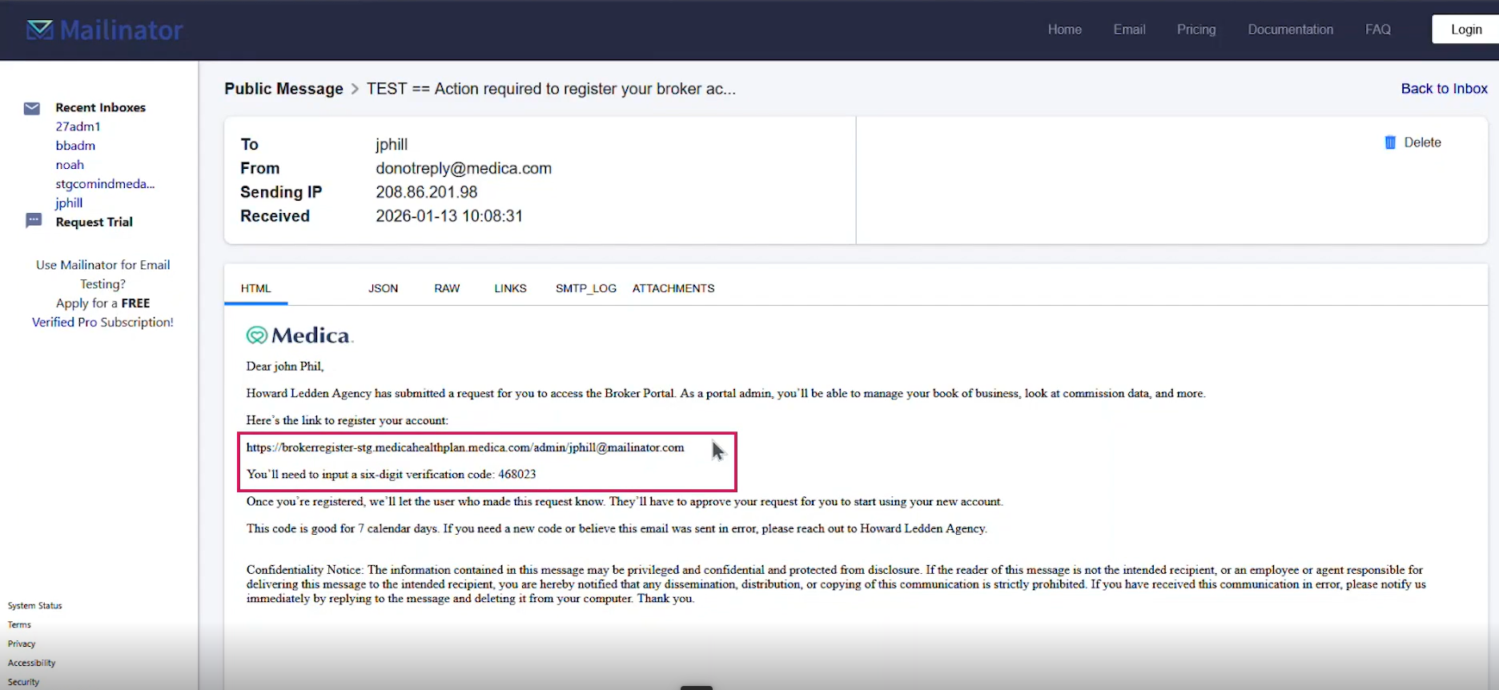
Admin View
The admin will receive an email with a link and code

Slide 22
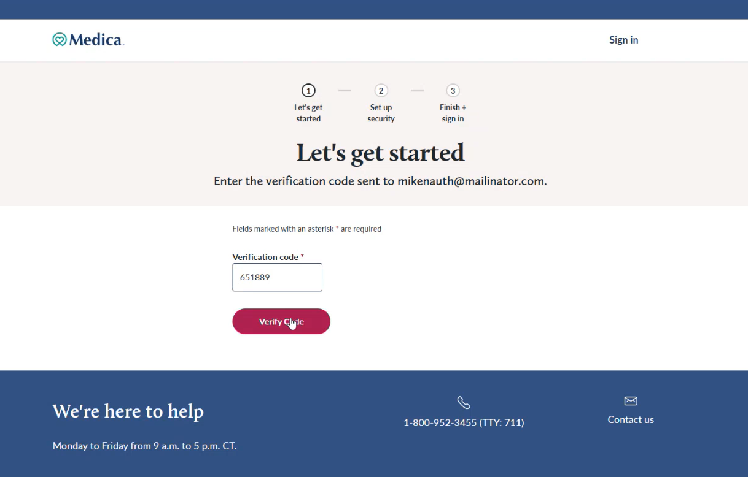
Admin View
The admin enters the verification code to proceed

Slide 23
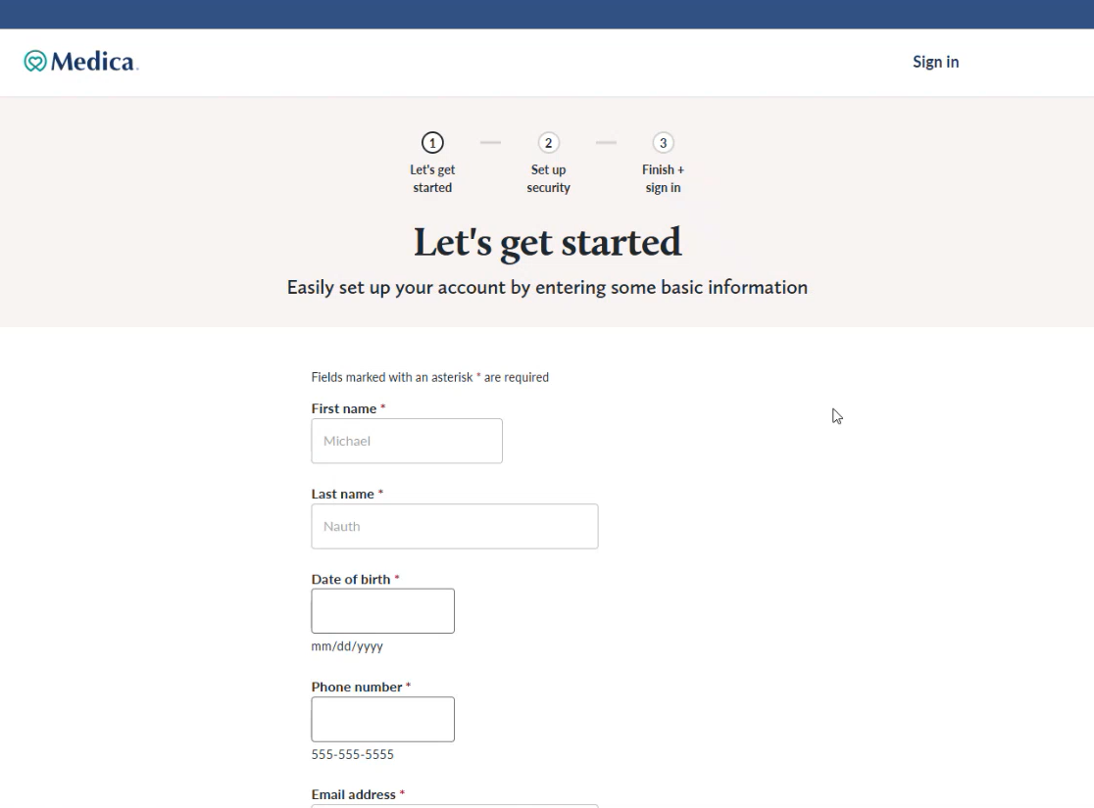
Admin View
Next, the admin enters their info

Slide 24
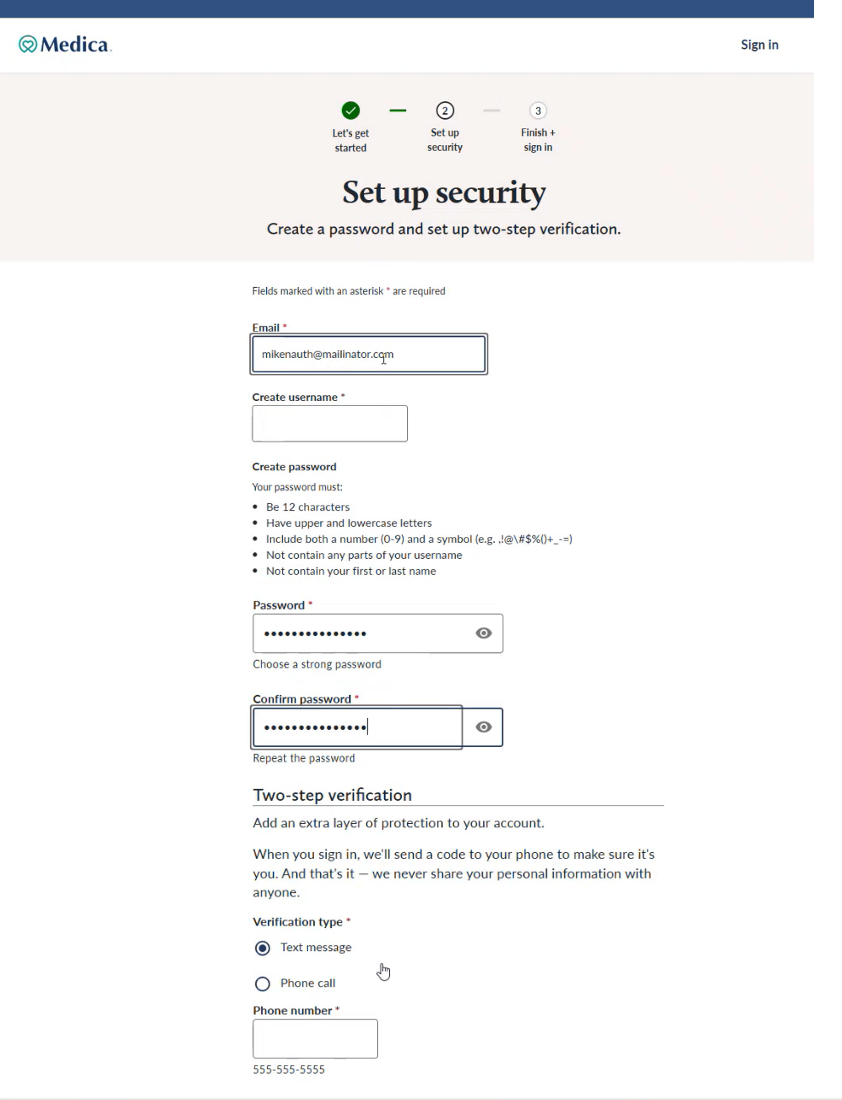
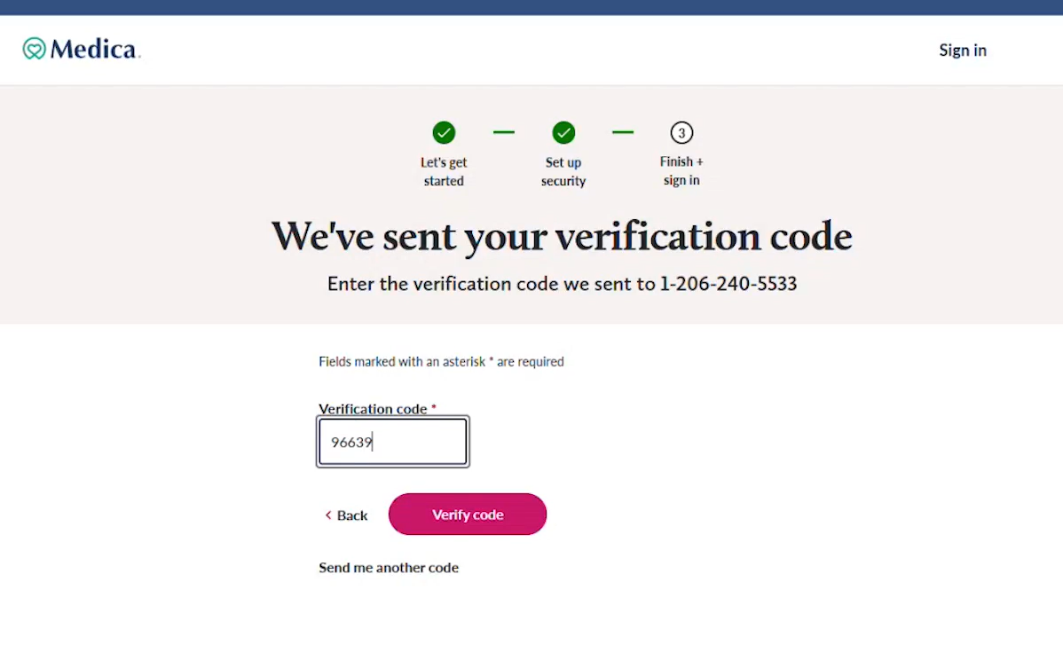
Admin View
The admin enters their username, password and verification info
Lastly, they enter their verification code to log in

Slide 25
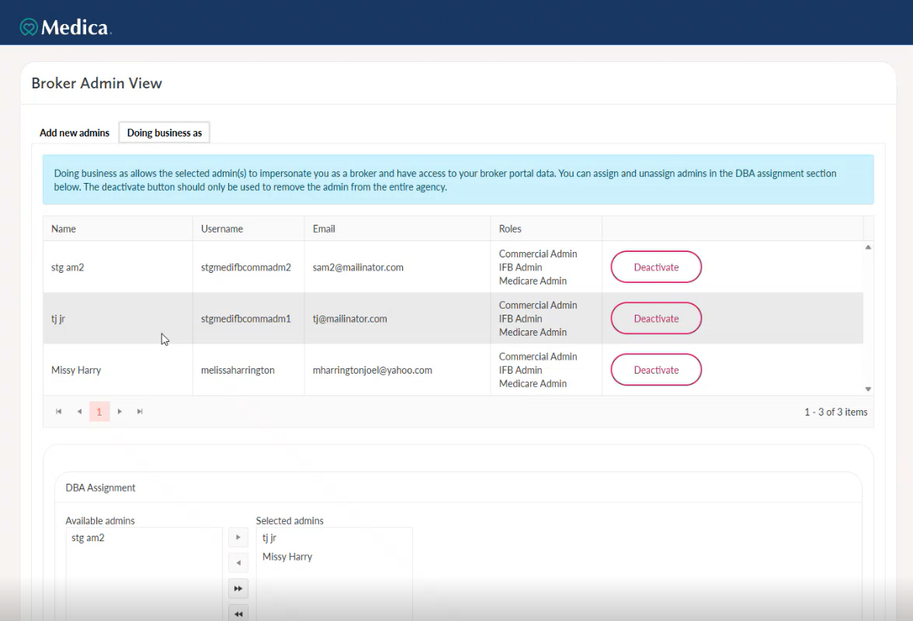
Agent View
The agent can select which admin(s) they want to help with their business in the portal

Slide 26
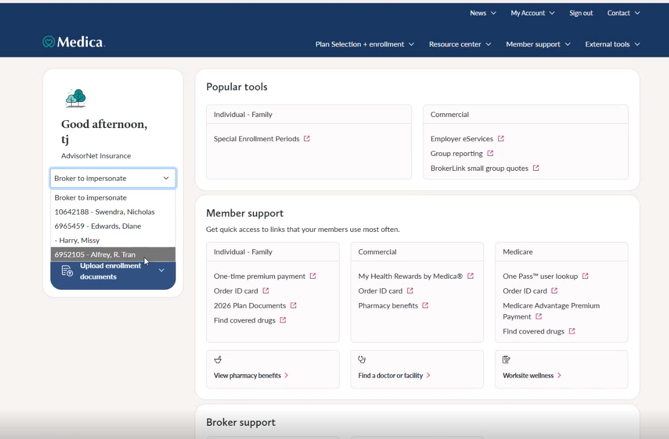
Admin View
The admin can select which agent they’d like to impersonate

Slide 27
Next steps
The updated portal experience is scheduled to go live Friday, March 6
A broker alert email will be sent to all agents when the site is live

Slide 28
Questions?

Slide 29
Thank you

